Slide 1

Summary of Findings: Skytrax Reviews of BA Customer Experience
26/1/2024

Slide 2
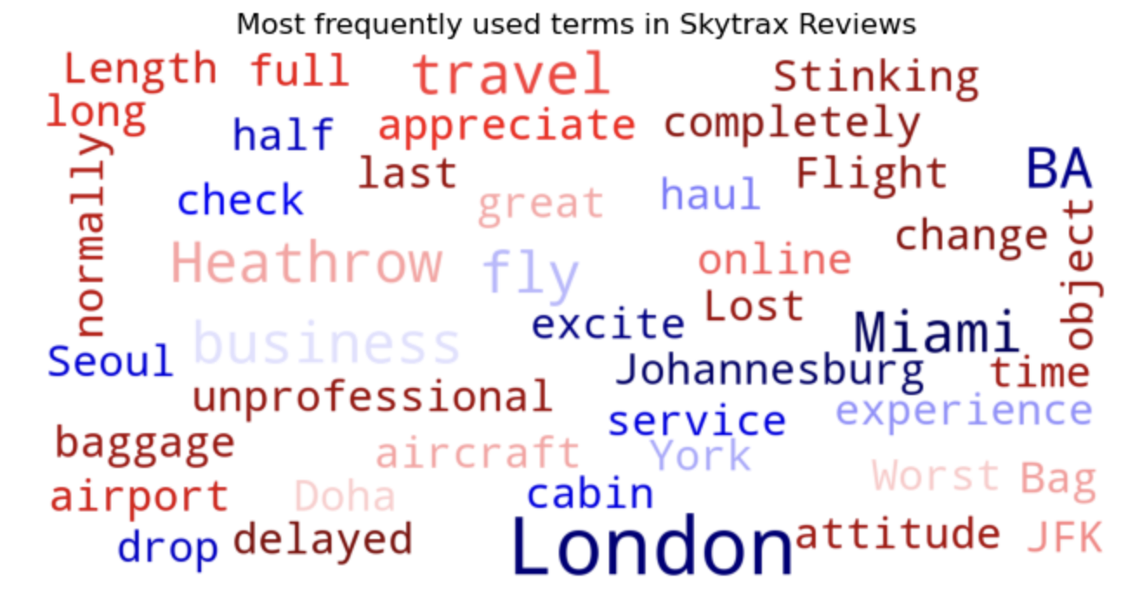
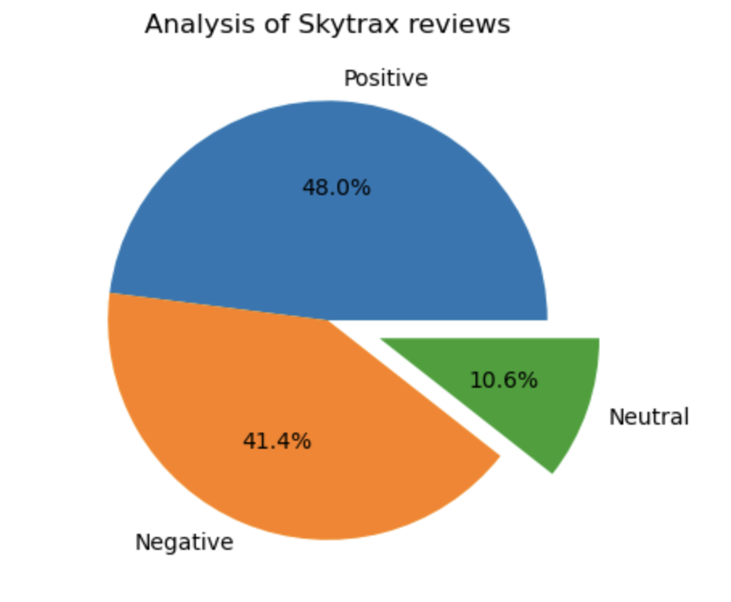
From a sample of the 1000 most recent reviews concerning British Airways’ services,
480 were positive,
414 were negative,
and the remainder (106) were neutral in relation to overall sentiment.
This emphasises that although BA’s services are mostly seen as exemplary, a large proportion of reviews were negative, highlighting areas for improvement.
The most popular terms that showcase customer experience of British Airways include:
- great
- appreciate
- worst
- delayed
- unprofessional
Although some of these issues may be out of the company’s control, it is important to manage and mitigate any further issues with customer service and experience.

